Slide 1
Programme Readiness & Fees Table and Parent Statement
Walkthrough and Demonstration

Slide 2
What will the session cover?
Setting up your Service
Updating the Service Details
Upcoming Changes in 2024/2025
Changes to the ECCE Calendar
Changes to the NCS Subsidies.
Fee Table and Parent Statement
Copying last year's fee table
Fee options and fee extras
Partner service fee table
Recap on tasks required
Live Demonstration

Slide 3
Updating your Service Details
Primary Authorised User (PAU)
Organisation Details
Bank Account
User Roles
Service Provider TUSLA Registration details for each type of care offered
Service Calendar
Fees Table & Parent Statement
Pre-contracting Steps (ECCE Only)

Slide 4
Upcoming Changes 2024/2025

Slide 5
Upcoming Changes 2024/2025
ECCE Service Calendar
Service providers must submit their ECCE calendar by the Monday 19 August.
After 19 August, Service Provider’s will not be able to make any retrospective changes to the calendar, in line with rule 4.4 of ECCE Programme Rules
In line with ECCE programme rules any changes to the service calendar must be approved in advance by their local CCCs
Parents/guardians must be given 20 working days written notice in advance of any changes
Copies of notice to the parents must be kept on file.
The purpose of this is to align with all the calendars meaning that there is no retrospective changes available on any calendar on the Hive. Service providers will not be able to change a closed/open day in the past.

Slide 6
Upcoming Changes 2024/2025
Changes made to the NCS Subsidy
The NCS subsidies will increase from 2 September 2024. After 2 September, service providers may have to recalculate co-payments related to affected claims.
All affected Chicks have been uplifted and applicants have been informed of the upcoming increases.
To assist with identifying which NCS claims in your service have been impacted, a new page called ‘Budget 2024 Claims affected’ is available on the Early Years Hive (from 3 May 2024).
This page can be found under the NCS section of the Programmes menu on Hive and will display the claims that have changed.

Slide 7
Fees Table and Parent Statement

Slide 8
Fee Table 2024/25 - Overview
A 2024/25 Fee Table must be submitted in advance of contracting into any programme
It will be possible to copy information from last years Fee Table into the new Fee Table.
Once you have submitted the 2024/25 Fee Table once, it will not be possible to copy last years fee table again
The Fee Table will be available to print in both Irish and English and will be displayed on the Childcare search on the Applicant Portal for each Service Provider.
Up to date fee table and parent statement must be printed and displayed in an accessible area for parents/guardians to view and on any online platform maintained by the service provider e.g. website.

Slide 9
Approved Provider or Partner Service?
If a Fee Table is submitted before 31 August, the current service status will be displayed i.e partner or approved.
If the service provider wishes to change this status, they must change the selection and then save as draft, and then edit the draft version.
After 31 august, the service status will be verified against 24/25 core funding status and the service provider will not have the option to change this on the fee table

Slide 10
Copying last years Fee Table
The service provider can now copy a version of last year's Fee Table
The service provider must review and submit this Fee Table if there are no changes to your Fee options or Fee extras from the previous Programme year to the next.
The service provider can also use the Edit or Save As functions to amend or add any of Fee options/Fee extras within the copied Fee Table.

Slide 11
'Errors Found'
A new 'Errors Found?' column is now available to highlight any errors found on the Fee Table. It will not be possible to submit if any errors are set to 'yes’.
If errors are found they must be amended in order to submit.
Example of errors - if the start and end time of a session has been calculated incorrectly from last years fee table

Slide 12
Fee Options and Fee Extras
Fee Options:
A new question has been added stating "Is the session split in two?" If the user selects yes, they will be able to input a second session start and finish time. E.g. Breakfast club/ Afterschool Club
The session Finish Time cannot be equal or earlier than the Start Time this will block the submission of the fees.
The Second Session Start and Finish time cannot be equal to the First Session Start or Finish time.
If the session is split in two, the hours per day is calculated using both of the Session Start times and Session Finish times.
Fee F

Slide 13
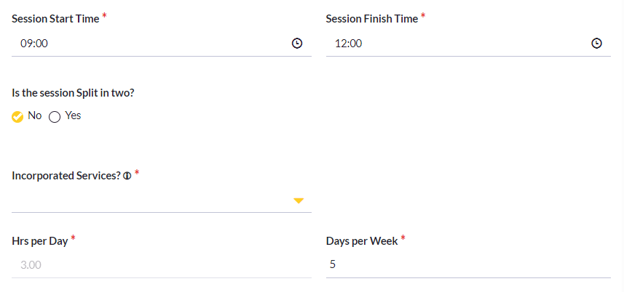
Fee options ctd.
Two enhancements to Fee Table were included this year.
Non-ECCE only Fee Table: The session start and session end times of a Fee Option will now auto calculate.
ECCE only Fee Table: The session end time will auto calculate from the hours selected in the drop down of daily hours.

Slide 14
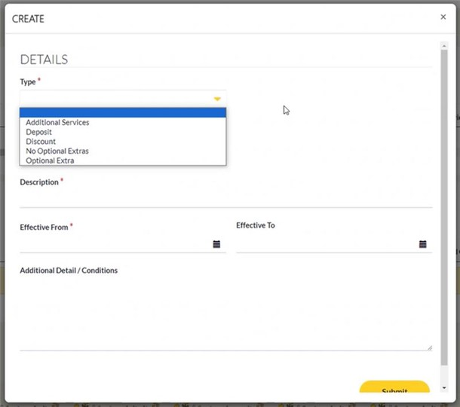
Fee Extras:
As per the ECCE Programme Rules, service providers must clearly indicate that they do not offer optional extras.
If service does not offer any optional extras the service provider must select ’no optional extras’ in the fee extra section of the Fee Table.

Slide 15
Partner Service Fee Table
Inclusion of Fee Caps:
A cap on fees will be in place from 1st September 2024. These will only apply to first time partner services who contract into Core Funding for the first time in the 24/25 Programme Year.
The cap on fees will extend to all Partner Services in the 25/26 Programme Year.
The maximum allowable fee under each fee cap band will be reviewed by DCEDIY on an annual basis.
Fee Band | Hours per week offered under fee option | Maximum allowable fee for New Partner Services
A | Less than 10 hours | €65
B | 10 hours to 19hours 59 minutes | €130
C | 20 hours to 29 hours 59 minutes | €195
D | 30 hours to 39 hours 59 minutes | €260
E | 40 hours to 49 hours 59 minutes | €325
F | More than 50 hours | €390

Slide 16
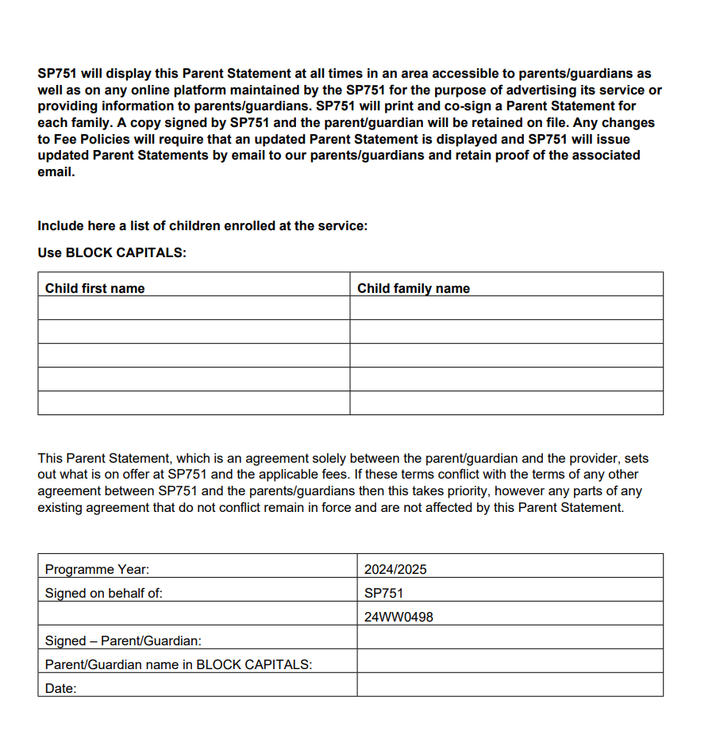
Parent Statement
A Parent Statement must be created after the Fee Table has been submitted.
A Partner Service parent statement will be made available to Partner Services.
Approved parent statement will be available to Approved Providers.
You must provide an up-to-date parent statement to each family in your service for the 2024/25 programme year.
Parent Statement needs to be physically signed by parent and provider and kept on file
Only the last page of the parent statement needs to be printed, signed and returned. A new page has been included for this purpose on the Parent Statement.

Slide 17
Parent Statement ctd.
Each time a change is made to the Fee Table, the parent statement must be updated and re circulated to Parents/Guardian, however you do not need to obtain a new signature, but proof of circulation should be kept on file.
If the service status changes at any point throughout the year, e.g. an approved provider becomes a Partner Service, a new version of the Parent Statement must be updated and circulated to parents/guardians and you will need to obtain a new signature from the parents.
Up to date fee table and parent statement must be printed and displayed in an accessible area for parents/guardians to view and on any online platform maintained by the service provider e.g. website

Slide 18
Recap on tasks required
Complete all programme readiness steps (including Fee Table and Contracting)
Update Parental Statement and circulate one per family
ECCE providers must provide an Applicant Declaration to parents/guardians
CCSP Savers providers must provide Applicant Declaration to parents/guardians
Up to date fee table and parent statement must be printed and displayed in an accessible area for parents/guardians to view and on any online platform maintained by the service provider e.g. website.

Slide 19
Live Demonstration – Early Years HIVE

Slide 20
Questions? Thank you for attending! Programme Readiness & Fees Table and Parent Statement

