Slide 1
CCC Introductory Workshop Core Funding & Ready Reckoner
01 April 2022

Slide 2
Introduction
The purpose of this workshop is to share the background, rationale and ambition of Core Funding.
We will make time at the end to take questions in case there are any specific details you have been uncertain about.
First, we will go through a brief introduction to Core Funding and some clear examples of realistic services to put the information that has been issued by the Department in context.
Hopefully you will all recognise these services as similar to your own, although again, we will make time for questions at the end if there are any specific details that are causing trouble.

Slide 3
Workshop Plan
Introduction to Core Funding
Core Funding’s Budget
Calculation and Allocation
The Joint Labour Committee and Employment Regulation Order
Additional Clarifications
How to Use the Ready Reckoner
Discussion
Notes:
Introduction to Core Funding
Principles of the New Funding Model
The New Funding Model & Core Funding
Aims of Core Funding
Requirements of Core Funding
Core Funding Application Process
Core Funding’s Budget
DCEDIY Budget
Core Funding Budget
Base Rate Funding distribution
What does Capacity mean?
Funding Guarantee

Slide 4
Principles of the New Funding Model
Strategic: ELC and SAC should be delivered for the public good, for children and families, using public management tools. Issues with existing funding approaches must be remedied.
Child-centred: in the best interests of children, ensuring equitable access and participation
Family orientated: support parents to participate in employment, education or training; accommodate reasonable needs and choices of parents; mitigate the cost to families of ELC and SAC
Professional and valued workforce: quality of ELC and SAC is reliant on the quality of the workforce - qualifications; fair pay and working conditions; and feeling valued and motivated
Competent Sector: continuous quality improvement, innovation, and interagency working; respect the existing diversity of scale and service offering, while allowing for longer-term changes required to support a sustainable sector; reflect the reasonable costs to providers, including the differential costs of delivery for different ages; robust regulation and accountability for public funds
Development and implementation: funding model developed with input from stakeholders; evidence-based, informed by existing data, research; incorporate mechanisms for future data collection, evaluation, and review; as transparent as possible

Slide 5
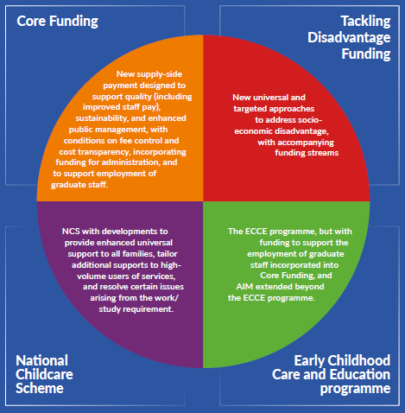
The New Funding Model & Core Funding
Core Funding was first laid out in the Report of the Expert Group, Partnership for the Public Good a New Funding Model for Early Learning and Care and School-Age Childcare. The new funding model consists of four elements:
Notes:
The key messages to highlight in regard to the four elements of the new funding model are these:
Tackling Disadvantage Funding: The Department plans to launch new universal and targeted approaches to addressing socio-economic disadvantage, with accompanying funding streams. Developing these will be the next project after Core Funding is implemented.
ECCE: ECCE will continue as part of the new Funding Model, alongside Core Funding and the other elements. However, funding to support the employment of graduate staff is being incorporated into Core Funding, and the Department also plans to introduce measures that will extend AIM to children outside ECCE age.
NCS: NCS will also remain as part of the new funding model, with some recommendations from the Expert Group already adopted and coming into effect in now – these are an extension of the NCS universal subsidy to all children under 15, and an end to the practice of deducting hours spent in pre-school or school from the entitlement to NCS subsidised hours from spring 2022, benefitting an estimated 5,000 children from low income families.

Slide 6
Aims of Core Funding
Core Funding is a new funding stream that marks the beginning for a new kind of relationship between the State and childcare providers who wish to deliver high-quality and affordable services in the public interest and in partnership with the State.
Under this partnership, the State and providers will shape a future of childcare provision to deliver greater outcomes for children and more affordability for parents.
Core Funding will:
operate alongside the NCS and ECCE, and will ensure that parents feel the benefit of these schemes to the greatest possible extent.
provide greatly increased funding to the sector through new mechanisms which will improve stability and sustainability to service providers.
facilitate improved staff pay and conditions in the sector - to support the single biggest and most important issue in relation to quality which is the impact that pay and conditions in the sector is having on the ability to recruit, motivate, develop, and retain a workforce that can provide children with the stable and consistent interactions upon which early childhood development depends.
benefit all providers regardless of the form or scale of their provision.

Slide 7
Requirements of Core Funding
Providers who sign up to Core Funding will be required to:
Follow the fee management system, commencing with the Fee Freeze.
Provide transparent financial reports and participate as required in cost surveys and other necessary data-collection exercises.
Actively offer the NCS and ECCE programmes to all eligible children/parents.
Implement the quality improvement measures under the Workforce Development Plan.
Implement the relevant practice frameworks.
Develop, implement, and report on an annual quality development plan.
Notes:
Additional details relating to the above will be provided in advance of the Core Funding contracts having to be signed.
‘Actively offer NCS and ECCE’
Regarding the requirement to actively offer NCS and ECCE, this requirement is dependent on the type and scale of service a provider offers – for example, some services which operate as sessional ECCE-only services (less than 3.5 hours a day, usually pre-school) and it is understood these cannot offer NCS.
This requirement is designed to encourage widespread participation by parents and providers – at present, many parents do not avail of and providers do not offer the NCS, either because they are not aware of the scheme or regard the subsidy as insufficient to make it worthwhile. To encourage this, services of the appropriate type must actively offer the NCS and ECCE programme to all eligible children/parents, including children accessing the NCS through sponsorship arrangements.
.

Slide 8
Core Funding Application Process
Stage 1 of the application process opens in April:
Begins with the Sector Profile and Income & Costs Survey, which is a pre-requisite for application for Core Funding. Collection of data for the Annual Early Years Sector Profile will cease at the end of April, but services will remain able to complete the survey and apply for Core Funding for the whole programme year.
Information provided in the Sector Profile will not be used in assessing applications for Core Funding. The purpose of the Sector Profile survey, including the Income and Costs question, is to create an aggregated picture of the sector pre-Core Funding. This is especially important this year, in order to set a baseline against which the impact of Core Funding can be measured in subsequent years.
Stage 2 of the application process opens in June:
Providers define their service’s profile and their capacity in detail in an online form
Core Funding value is communicated to providers (subject to final verifications and confirmations)
The provider contract will be published so applicants can review what they will later be asked to sign
Stage 3 of the application process opens in August:
Individual contracts will start to be made available to successful applicants for signature
Payments to providers commence at the end of August. Payments will be made monthly, in advance, throughout the programme year.
Notes:
Stage 1
NB1: There has been some confusion around timing of the AEYSP and Core Funding; hopefully the statement here clears it up: services will be able to complete the survey and apply for Core Funding after data collection for the AEYSP ends. However, we would urge them to complete the survey before the data collection closes for all the usual reasons we encourage participation in the AEYSP.
Stage 2
NB: 2. If you've used the RR you may have already some indication of what you may be likely to receive, if you haven’t and would like support in doing so please do not hesitate to contact us.
Stage 3
Payments will be in 12 equal payments meaning that their funding allocation is calculated on the basis of the number of weeks they are open but this total is then spread out over 12 months, including the summer.
NB 3: We have received some questions from services concerned that they cannot complete the Sector Profile or apply for Transitional Funding without being ‘tied in’ to Core Funding. It is important to emphasise that services will have no obligations unless and until they opt to sign the Core Funding contract in August. Even if they have supplied application details in June, they can still decide to opt out of Core Funding and are under no obligation to sign the Core Funding contract in August. Even after signing the Core Funding contract and receiving some of their funding allocation, a service will be able to withdraw from Core Funding if this is something they wish to do.

Slide 9
DCEDIY 2022 Budget
€716 million across the vote
€272.6m ECCE
€200.3m NCS/Schemes
€33m AIM
€19.4m PSP
€37m Transition
€73.5m Core Funding (September-December costs)
€85.6m System and Supports (Sustainability, Pobal, Better Start, County/City Childcare Committees, National Voluntary Childcare Organisations, Learner Fund, Childminding initiatives etc.)
No scope for additional budget allocation in 2022

Slide 10
Core Funding Budget
€221m (full-year) allocated to Core Funding
→ includes €14.4m in reallocated investment since Budget announcement
€138m to support staffing costs and improve pay and conditions
JLC to determine implications
Expectation that this will be used for this purpose
€25m to support administration
(Incorporating old PSP budget of €19.4m)
€20m to reflect increases in non-staff overheads
First time this type of funding has been provided – increase of €10.9m since original allocation
To enable fee conditionality and protect other budget elements of total package
€38m to support the employment of graduates
Replacing ECCE Higher Capitation (old budget: €28.8m)
Rectifying anomalies in existing approach to funding for graduates
Extending support for graduates to Lead Educators across ELC and to ELC and ELC/SAC managers

Slide 11
Base Rate Funding distribution
Age of child | Ratio | Value of Core Funding per place per hour | Flat rate (admin and non-staff costs) | Scaling (staff costs)
Full-time (5+ hours per day) and Part-time (3.5 hours – 5 hours per day)
0-1 year of age | 3:1 | €1.66 | €0.18 | €1.48
1-2 years of age | 5:1 | €1.07 | €0.18 | €0.89
2-3 years of age | 6:1 | €0.92 | €0.18 | €0.74
3-6 years of age | 8:1 | €0.68 | €0.18 | €0.50
Sessional (up to 3.5 hours per day)
0-1 year of age | 3:1 | €1.66 | €0.18 | €1.48
1-2.5 years of age | 5:1 | €1.07 | €0.18 | €0.89
2.5-6 years of age | 11:1 | €0.65 | €0.18 | €0.47
School-age
4 – 15 years of age | 12:1 | €0.55 | €0.18 | €0.37

Slide 12
What does Capacity mean?
The amount of money available to providers will be determined by their capacity, plus additional uplifts for ELC room leaders and managers of ELC and combined ELC & SAC services who are ELC graduates.
Capacity is defined here as the number of childcare places a service can provide while adhering to the requirements under the Regulations for age ranges/session types/ratios.
Allocations for Core Funding will therefore be based on service capacity and not on child registrations and attendance levels, therefore it will not fluctuate based on registrations or on children’s attendance patterns.
This type of funding alongside the existing schemes will contribute to services’ stability and sustainability.
The amount payable under Core Funding will be determined at the start of the programme year and will be paid to providers in equal instalments over a 12 month period. The existing schemes will continue to operate alongside Core Funding with funding distributed based on child registrations and attendance for those schemes.
Notes:
Core Funding allocations will not fluctuate based on children’s attendance patterns, however the required/necessary staffing levels related to the capacity will need to be maintained.
Places do not have to be filled in order for Core Funding to be allocated. However, for capacity to be funded, the necessary levels of staff must be in place. The staffing required depends on the age group and session types of the places available. The capacity of a service is also limited by the regulatory space requirements. For more information see Question 1 of the Core Funding Ready Reckoner FAQ V1.
The existing schemes will continue to paid according to their usual payment schedules

Slide 13
Graduate Premium Calculation
Rationale for change in approach to calculating payments to providers in respect of graduates
Extend support for the employment of Graduate Lead Educators outside of the ECCE programme to ensure that children in other parts of the ELC system have the opportunity to benefit from graduate-led provision.
Allow for a Graduate Premium to be paid in respect of Managers of ELC or combined ELC/SAC services. This is because of the strong evidence of the importance of graduate leadership in shaping quality for children.
Bring the financial support for Graduate Lead Educators more closely in alignment with the costs of delivery for that type of provision.
ECCE higher capitation has been paid on the basis of the number of children participating in the ECCE session, not the number of hours of ELC being led by a graduate. An ECCE room with 22 children currently receives 2.75 times the level of higher capitation funding than an ECCE room with 8 children, despite the fact that the cost of the staffing requirement remains the same in both instances.
Core Funding provides an opportunity to rectify that anomaly as well as extend funding for graduates beyond the ECCE programme to other aspects of ELC provision.
For this reason, the Graduate Lead Educator Premium in Core Funding is paid based on the number of hours of provision that is led by a graduate, rather than the number of children that are participating in that room.

Slide 14
Funding Guarantee
A small number of services would have seen a slight decrease in total funding under the new scheme.
However, the Department has issued a Funding Guarantee:
All services will receive at least the same level of funding in Core Funding as they received from higher capitation and PSP in the 2021/22 programme year, assuming the numbers of children, graduate staff and type of service offered remains the same (Reminder: ECCE and NCS will continue as normal)
There is a proportion of services that will not see a very large increase in funding. However, they will still benefit from the stability offered by Core Funding.
Notes:
Because of the different way Core Funding is calculated compared to ECCE Higher Capitation and the Programme Support Payment, there are a small number of services that would have seen a slight decrease in total funding under the new scheme. However, the Department has issued a Funding Guarantee – any service that has the same capacity in 2022 as in 2021 will receive at least as much in Core Funding as they received in Higher Cap and PSP.
This does mean that there are a proportion of services that will not see a very large increase in funding. However, they will still benefit from the stability offered by Core Funding. Services affected in this way will primarily be ECCE-only services with full graduate-led provision that are currently full; these services are already receiving about as much money as they will be eligible for under Core Funding. But crucially, under the other older schemes (ECCE, Higher Capitation, and Programme Support Payment) which are tied to attendance, all of their income streams would be reduced if a couple of children left and the places weren’t filled –. Core Funding offers greater stability: while ECCE payments will still decrease if registrations do, Core Funding will not.
The details around the process for the Funding Guarantee will be available with the Application Form for Core Funding.

Slide 15
Employment Regulation Order
Proceeding with Core Funding at the rates previously published is contingent on an ERO being agreed. If an ERO is not agreed additional details regarding this will be provided at that point. What this workshop can provide is additional clarity on what an ERO is.
Joint Labour Committee (JLC): JLCs are bodies made up of equal numbers of employer and worker representatives to agree and set minimum rates of pay and conditions for employees in particular sectors.
Employment Regulation Order (ERO): An ERO is an instrument drawn up by a JLC and given statutory effect. The ERO fixes minimum rates of pay and conditions of employment for workers in specified business sectors: employers in those sectors are then obliged to pay wage rates and provide conditions of employment not less favourable than those prescribed.
Notes:
Joint Labour Committee (JLC): Joint Labour Committees (JLCs) are bodies established under the Industrial Relations Acts to provide a process for fixing statutory minimum rates of pay and conditions for employees in particular sectors. A JLC is made up of equal numbers of employer and worker representatives appointed by the Labour Court and a chairman and substitute chairman appointed by the Minister for Enterprise, Trade and Employment.
Employment Regulation Order (ERO): An Employment Regulation Order (ERO) is an instrument drawn up by a Joint Labour Committee (JLC), adopted by the Labour Court, and given statutory effect by the Minister for Enterprise, Trade and Employment. The ERO fixes minimum rates of pay and conditions of employment for workers in specified business sectors: employers in those sectors are then obliged to pay wage rates and provide conditions of employment not less favourable than those prescribed.

Slide 16
Employment Regulation Order
Current Status
In line with the provisions of the Industrial Relations Acts, the Joint Labour Committee is independent in its functions, and neither the Minister nor the Department have a role in its statutory processes. This means that the Department is not able to provide us with a detailed update of where the JLC is right now. The Department has provided data and technical briefing to the JLC.
The JLC began the discussion in December 2021.
The representative organisations in the Committee are:
Irish Business and Employers Confederation (IBEC – 5 representatives) and Irish Small and Medium Enterprise Association (ISME – 1 representative) on behalf of employers
Irish Congress of Trade Unions (ICTU – 6 representatives) on behalf of employees

Slide 17
Employment Regulation Order
Next Steps
Should the JLC develop a proposal for an Employment Regulation Order, it will publish a notice and look for representations from employers and employees in the sector to take their views on board.
It may then be adopted (or adopted with amendments), and it would then pass to the Labour Court and the Minister for Enterprise, Trade and Employment to be implemented.
Current Status of the process:
https://www.workplacerelations.ie/en/cases/2022/april/lcr22575.html
It is important to note that if an ERO comes into effect as an employer in the sector you will be bound by the conditions it sets whether you are signed up for Core Funding or not.

Slide 18
Clarifications
Funding for non contact time
Non-contact time is factored into the €138m for staff costs using data from Sector Profile on current amount of contact and non contact time for different grades of staff
Funding allocated in line with contact hours, but % for non-contact time is built in
Separately, €25m is available to further support administrative time
Recognition for staff without a L7+ qualification
€138m has been allocated for staff costs to improve pay and conditions for staff across the sector, regardless of qualification level.
An additional €38m has been allocated to graduate premiums for lead staff with L7+ qualification

Slide 19
Clarifications
Core Funding Contract Conditions
Contract conditions have been available since the publication of Partnership for the Public Good
Conditions will primarily be about fee management; quality improvement measures; implementation of practice frameworks; transparent financial reporting and other data collection; offering NCS and ECCE
Contract will be published in June, required to be signed in August
Core Funding assumptions are based on current data
Core Funding uses a large number of data sources, both recent and trend data
Sector Profile up to June 2021; administrative data (84% children receive funding); financial impact returns from Case Management; Tusla register; data from Revenue; independent analysis of providers’ income and cost (2018 and 2021); data on unit cost of delivery and staff/non-staff cost drivers; macro-economic and population trend data

Slide 20
Clarifications
PSP
The budget for PSP (€19.4m), plus an additional €5.6m, has been incorporated into the Core Funding budget
Statutory Sick Pay
Statutory sick pay will initially be paid at 70% of regular earnings up to a cap of €110 per day, from the first day of illness for a maximum of three days per year.
If max entitlement used, this would equate, in percentage terms, to an additional cost for employers of around 0.8%
This is factored into the estimated staff costs allocation in Core Funding
For employers who genuinely cannot afford to pay, included in the sick pay proposals is an ‘inability to pay’ provision exemption from the Labour Court

Slide 21
Clarifications
Sector Profile and Income and Cost Survey
Sector Profile (including Income and Cost data) are key information sources to justify the case for increased investment
New Funding Model is intended to operate as a partnership for the public good – requires transparency and openness on both sides
Very substantial levels of public money are being invested in sector – There is a requirement to have proper oversight and assess outcomes of funding

Slide 22
Clarifications
Training
Core Funding can be used to support staff continuous professional development (CPD), and the ongoing development of quality at service level
DCEDIY provide funded training initiatives for early years educators e.g. Síolta Aistear, AIM training and others on a fully funded basis. LINC Level 6 special purpose award also available at no cost.
Graduate Bursary fund available for staff who have achieved a qualification at level 7, 8 or 9
Nurturing Skills will strengthen drive towards professionalisation – commits to funding places on flexible education programmes at levels 6 to 8 for current early years educators. This new funding will support upskilling and strengthen career development pathways for those working in the sector, reducing the cost to educators of undertaking further and higher education qualifications. The new funding scheme will also develop and introduce mechanisms for providing financial support to early learning and care services to help meet the costs of releasing staff to go on student practice placements and study leave. Plans for the new funding scheme are currently being developed.

Slide 23
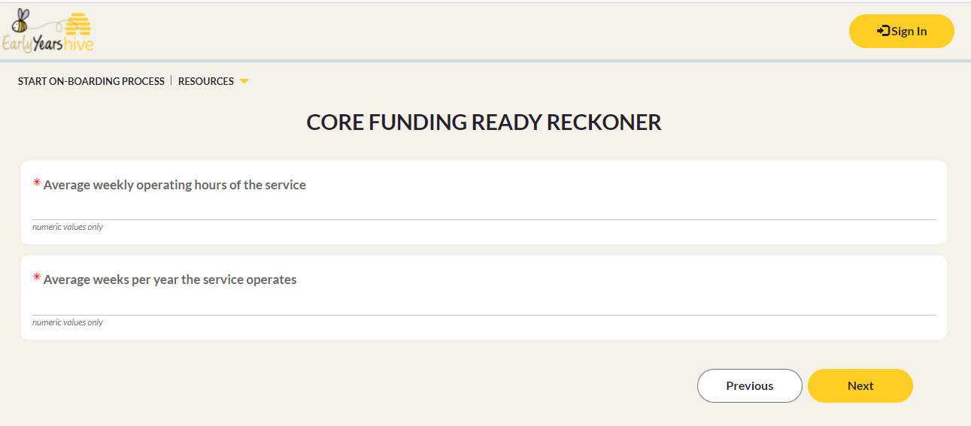
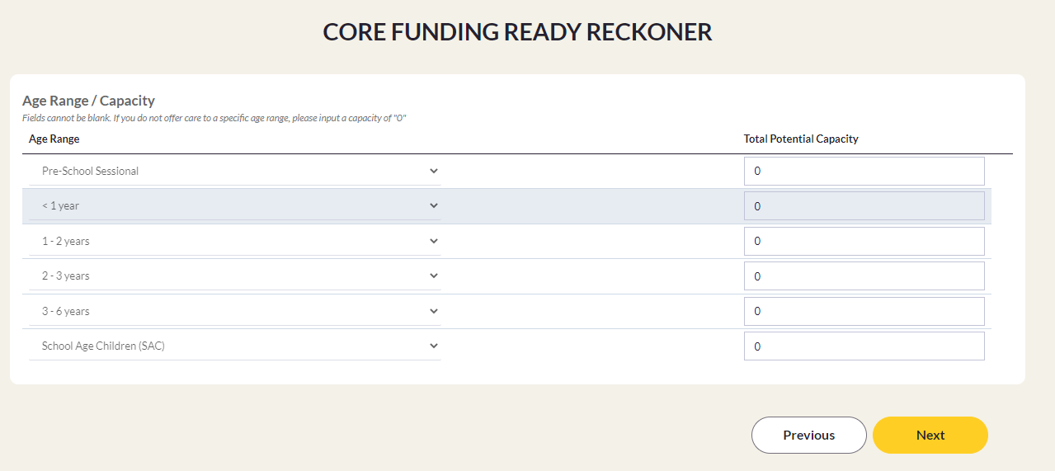
Ready Reckoner
Core Funding Ready Reckoner
Simple approximate calculation tool
Available on the Hive to everyone
Shows benefits of Core Funding
Can be used to test hypotheticals

Slide 24
How to Use the Ready Reckoner
On Monday 7th March the online tool became available to provide approximate estimates of potential Core Funding values for individual services.
The Core Funding value for an individual service will be calculated based on the following information:
The total service capacity per age range offered
The hours of operation of the service by week and weeks per year
The number of ELC graduate Lead Educators in ELC rooms in the service
If the ELC or combined ELC and SAC service has an ELC graduate as the service manager

Slide 25
How to Use the Ready Reckoner
There are two ways to use the Ready Reckoner: at service level and at session level.
To use the Ready Reckoner at service level, you enter averages to get an approximate answer to how much Core Funding you might be eligible to receive. Using averages does mean the answer will probably be less accurate, but this is a lot easier and may be all you need.
To use the Ready Reckoner at session level, you would enter the exact information for each session you run, note the results, and add them together (with a small extra step for the Graduate Manager Premium). This takes more work, especially for a big service, but will produce a more accurate estimate.

Slide 26
Common Ready Reckoner Questions
Q: How is the Graduate Manager Premium calculated for a manager whose working hours are not the full opening hours of the service?
A: This answer is different for the purposes of the Ready Reckoner and the Application. The Ready Reckoner uses the full opening hours of the service, but the Application will use the hours worked by the manager. This is one of the areas the Ready Reckoner was simplified for ease of use, and unfortunately that does mean this is one way your result may differ from your actual Core Funding offer later in the year. However, the difference should not be much.

Slide 27
Placeholder - Common Ready Reckoner Questions
Individual CCC may wish to add any common questions or misunderstandings they have encountered that they wish to address in this or additional slides.

Slide 28
Model Service Examples
What follows are the Model Service Examples, CCCs to choose which examples they want to include in their workshops.

